Slide 1
Capstone Project - The Battle of the Neighborhoods
Applied Data Science Capstone by IBM/Coursera

Slide 2
Introduction: Business Problem
A restaurant is a business which prepares and serves food and drink to customers in return for money, either paid before the meal, after the meal or with an open account. Toronto is a famous city. Its food culture includes an array of international cuisines influenced by the city’s immigrant history. So, it is evident that to survive in such competitive market it is very important to strategically plan.

Slide 3
Data
Various factors need to be studied in order to decide on location such as;
Toronto Population and demographics
Who are the competitors in that location?
Cuisine served / Menu of the competitors
Are there any Farmers Markets, Wholesale markets etc. nearby so that the ingredients can be purchased fresh to maintain quality and cost?
Are there any venues like Tourist attractions, Entertainment zones, Parks etc., nearby where floating population is high
Segmentation of the Borough
Untapped markets
Saturated markets etc. And the list goes on… Even though well-funded XYZ Company Ltd. needs to choose the correct location to start its first venture. If this is successful, they can replicate the same in other locations. First move is very important, thereby choice of location is very important.
To build a recommendation model, following datasets and information are considered for analysis;
Scrapped Wikipedia using Pandas, to extract information about 4 toronto boroughs also known as local authority districts. Also, considered local areas or neighborhoods for each borough for detailed analysis.
I used Foursquare API to get information about available restaurants for a given neighborhood and borough in Toronto. The API also provided information about restaurant styles based on cuisine.

Slide 4
Methodology
In this project we will analyze the Boroughs of Toronto and its neighbourhoods. We will use Geopy to find the latitude and longitude of Toronto and will search nearby restaurants in 500km radius area. For this we will use Foursquare API. Then we will cluster it by using k-means clustering which is an unsupervised clustering model. Based on this we will conclude about the project.

Slide 5
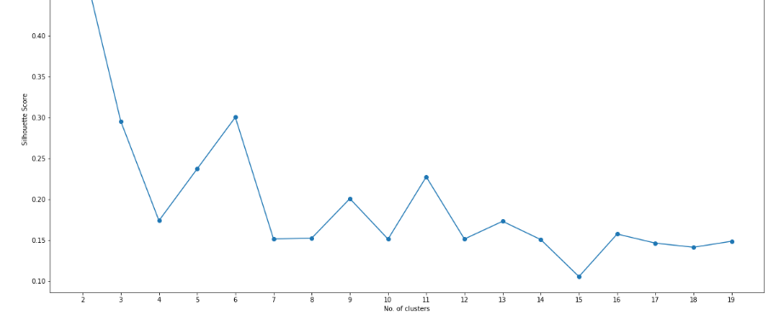
Finding the optimal value for clustering

Slide 6
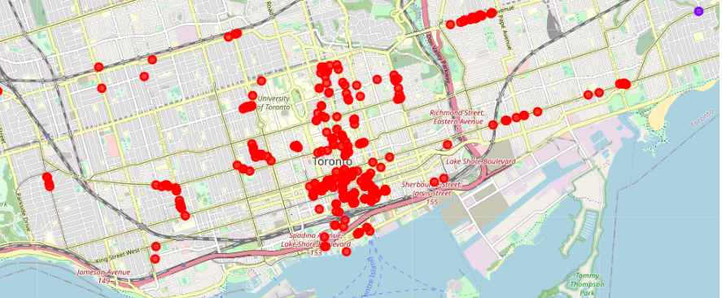
Visualizing cluster

Slide 7
Results
Cluster | 1st common restaurant | 2nd common restaurant | Least Common restaurant
1 | Restaurant | American Restaurant | French Restaurant
2 | Asian Restaurant | Vietnamese Restaurant | Eastern European Restaurant

Slide 8
Discussion
* If XYZ company want to open a restaurant in preferred location and irrespective of cuisine, refer to that neighborhood in specific cluster and chose cuisine with the least common restaurant for better profits
* If XYZ company want to open a restaurant with a preferred cuisine and irrespective of location, refer to the cluster with the least number of restaurants with that specific cuisine and select one among the neighborhoods based on company’s preference.

Slide 9
Conclusion
This analysis is performed on limited data. This may be right or may be wrong. But if good amount of data is available there is scope to come up with better results. If there are lot of restaurants probably there is lot of demand. Toronto has so many restaurants, yet certain neighborhood or borough doesn’t have a specific cuisine restaurant available. As per the neighborhood or restaurant type mentioned like Indian Restaurant analysis can be checked. A venue with lowest risk and competition can be identified.

